Slide 1


Slide 2
Agenda
Problem Statement 03
Data Mining - 01 04
Data Mining - 02 05
Exploratory Data Analysis (EDA) 06
Data Visualization 07
Algorithms Used 08
Analysis of Results 09
Conclusion & Future Work 10

Slide 3
Problem Statement
The data content comprises socio-economic information and insured vehicle details.
To analyze and develop machine learning models using the provided vehicle insurance data set to predict customer responses, aiming to enhance response rate and optimize marketing efforts for the insurance company.
Dataset contains both categorical and numerical variables. The customer lifetime value based on historical data has also been provided which is essential in understanding the customer purchase behavior.
Reference: https://www.kaggle.com/datasets/ranja7/vehicle-insurance-customer-data

Slide 4
Data Mining - 01
The data set consists of various data types such as :
Float - 02
Object - 16
Int - 06
The shape of the dataset is 9134,24 (rows, columns).
The dataset neither consists of missing values nor null values where the duplicate values can be identified by using the duplicate() function and the null values can be identified using isnull().sum() function.
The target variable in the dataset is ‘Response’.
The ratio between the majority class to the minority class of the target variable is 5.98:1 i.e. < 10. Hence, the dataset is a balanced one.

Slide 5
Data Mining - 02
In the dataset neither column ‘Customer’ nor ‘Effective To Date’ effect the target variable. So to improve the efficiency and accuracy of the model both columns are dropped using the del method.
By using label encoder, convert the categorical variables of object datatype into int datatype so that they can be fitted by machine learning models which only take numerical data.
The variables contain a different set of values without a range limit. Hence we scale the features into a specific range.
Now, use a scaling technique called MinMaxScaler to scale the values to a specific range of 0-1.

Slide 6
Exploratory Data Analysis (EDA)
Identify the dependent and independent variables.
The data is divided into X and Y, where X contains the data of independent variables and Y contains the data of dependent/target variable.
The data is split into train and test data using train_test_split of the model_selection library from sklearn package.
The train_test_split takes the parameters x, y ,test_size , random_state. Random_state is used to fix the train and test data.
After dividing the dataset into train and test, train data is used to train the model, and test data is used to test the accuracy of the model.

Slide 7
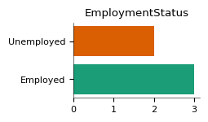
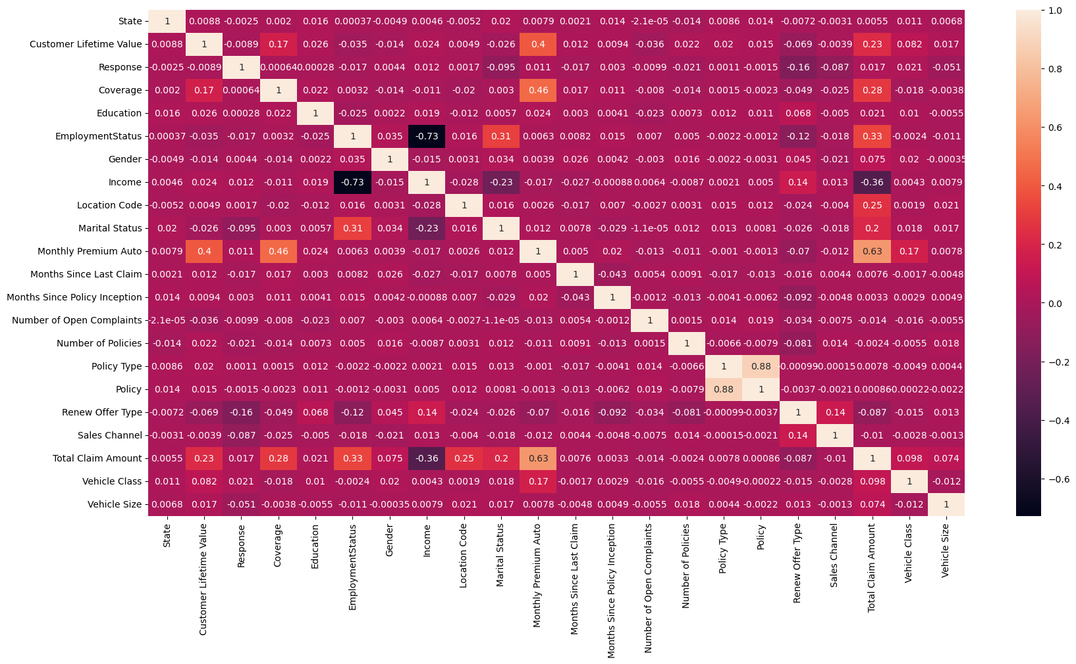




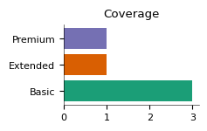
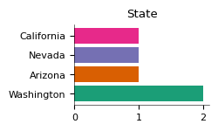
Data Visualization
The data visualization is done using matplotlib and seaborn libraries of Python.

Slide 8
Algorithms Used
The dataset contains the class labels. So it is supervised machine learning.
The target variable is categorical so we use a classification algorithm.
There are many classification algorithms. The algorithms used are:
Logistic Regression
Decision Tree Classifier
Random Forest
Extra Trees Classifier
Kneighbors Classifier
Naïve Bayes Classifier-Gaussian NB
Support Vector Machine
Among 7 algorithms, in the KNN algorithm there is a need to find the highest accuracy k value.
And also there are 4 types of models in SVM Algorithm and we have to choose the best kernel.

Slide 9
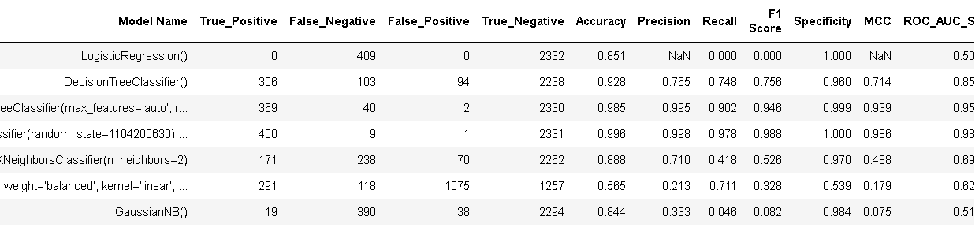
Analysis of Results
These models are compared based on the Confusion matrix and Classification Report.
The confusion matrix of the model should have a high true positive rate and a low false positive rate.
The classification Report contains Accuracy, Precision, F1_score, and Recall.
For KNN Algorithm k=2 and for SVM, SVM - Gaussian gives the best accuracy.
After evaluating various algorithms, we have found that the Extra tress classifier achieves the highest accuracy with 99.6%.

Slide 10
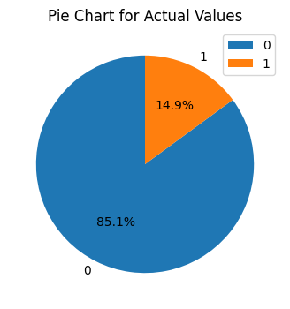
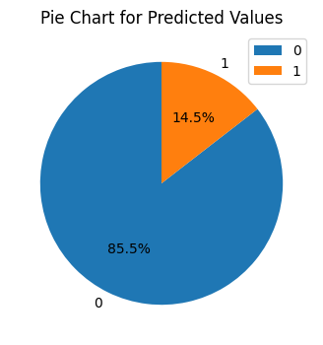
Conclusion and Future Work
I conclude that the model has produced good results so that it may help insurance companies in working in a most efficient manner through analysing the data.
Enhance model accuracy by integrating real-time data streams and dynamic risk assessment, while ensuring interpretability through explainable AI for transparent insights.
Frequent retraining and examination will be necessary to maintain reliability when external factors influencing the target variable change in the future.

Slide 11
Thank You
Q & A
VANKA D S N S D M NARASIMHA RAJA
21B91A6161
SRKR Engineering College
Mobile: +91 86396 65144
Email: 21B91A6161@srkrec.ac.in
Bhimavaram - India

